Slide 1
Chapter 3 Structured Program Development in C
C How to Program, 8/e, GE

Slide 2
3.2 Algorithms
The solution to any computing problem involves executing a series of actions in a specific order.
A procedure for solving a problem in terms of
the actions to be executed, and
the order in which these actions are to be executed
is called an algorithm.
Correctly specifying the order in which the actions are to be executed is important.

Slide 3
3.2 Algorithms (Cont.)
Consider the “rise-and-shine algorithm” followed by one junior executive for getting out of bed and going to work: (1) Get out of bed, (2) take off pajamas, (3) take a shower, (4) get dressed, (5) eat breakfast, (6) carpool to work.
This routine gets the executive to work well prepared to make critical decisions.

Slide 4
3.2 Algorithms (Cont.)
Suppose that the same steps are performed in a slightly different order: (1) Get out of bed, (2) take off pajamas, (3) get dressed, (4) take a shower, (5) eat breakfast, (6) carpool to work.
In this case, our junior executive shows up for work soaking wet.
Specifying the order in which statements are to be executed in a computer program is called program control.

Slide 5
3.3 Pseudocode
Pseudocode is an artificial and informal language that helps you develop algorithms.
Pseudocode is similar to everyday English; it’s convenient and user friendly although it’s not an actual computer programming language.
Pseudocode programs are not executed on computers.
Rather, they merely help you “think out” a program before attempting to write it in a programming language like C.

Slide 6
3.3 Pseudocode (Cont.)
A carefully prepared pseudocode program may be converted easily to a corresponding C program.
Pseudocode consists only of action and decision statements
Definitions are not executable statements.
They’re simply messages to the compiler.

Slide 7
3.3 Pseudocode (Cont.)
For example, the definition
int i;
tells the compiler the type of variable i and instructs the compiler to reserve space in memory for the variable.
But this definition does not cause any action—(such as input, output, a calculation or a comparison)—to occur when the program is executed.
Some programmers choose to list each variable and briefly mention the purpose of each at the beginning of a pseudocode program.

Slide 8
3.4 Control Structures
Normally, statements in a program are executed one after the other in the order in which they’re written.
This is called sequential execution.
Various C statements we’ll soon discuss enable you to specify that the next statement to be executed may be other than the next one in sequence.
This is called transfer of control.
During the 1960s, it became clear that the indiscriminate use of transfers of control was the root of a great deal of difficulty experienced by software development groups.

Slide 9
3.4 Control Structures (Cont.)
The finger of blame was pointed at the goto statement that allows you to specify a transfer of control to one of many possible destinations in a program.
The notion of so-called structured programming became almost synonymous with “goto elimination.”
Research had demonstrated that programs could be written without any goto statements.
The challenge of the era was for programmers to shift their styles to “goto-less programming.”

Slide 10
3.4 Control Structures (Cont.)
The results were impressive, as software development groups reported reduced development times.
Programs produced with structured techniques were clearer, easier to debug/modify and more likely to be bug free in the first place.
Research had demonstrated that all programs could be written in terms of only three control structures, namely
the sequence structure,
the selection structure and
the iteration structure.

Slide 11
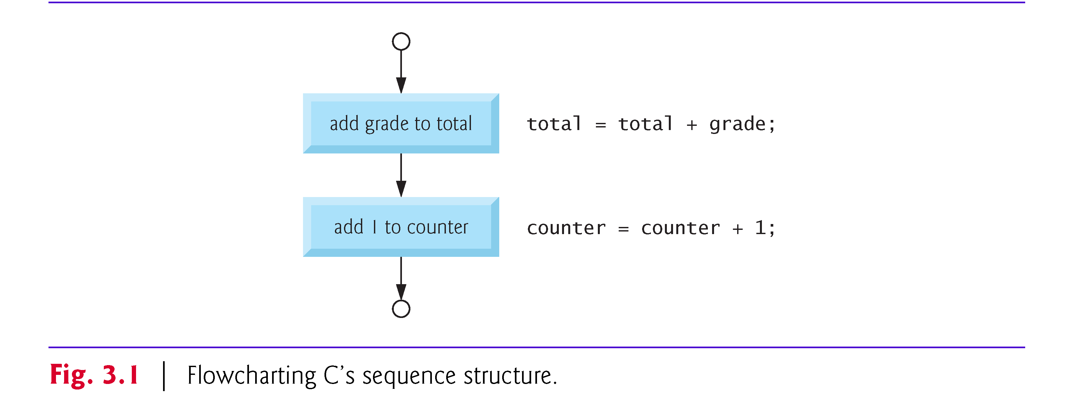
3.4 Control Structures (Cont.)
The sequence structure is simple, the computer executes C statements one after the other in the order in which they’re written.
The flowchart segment of Fig. 3.1 illustrates C’s sequence structure.

Slide 12
3.4 Control Structures (Cont.)
Flowcharts
A flowchart is a graphical representation of an algorithm or of a portion of an algorithm.
Flowcharts are drawn using certain special-purpose symbols such as rectangles, diamonds, rounded rectangles, and small circles; these symbols are connected by arrows called flowlines.

Slide 13
3.4 Control Structures (Cont.)
Consider the flowchart for the sequence structure in Fig. 3.1.
We use the rectangle symbol, also called the action symbol, to indicate any type of action including a calculation or an input/output operation.
The flowlines in the figure indicate the order in which the actions are performed—first, grade is added to total, then 1 is added to counter.
C allows us to have as many actions as we want in a sequence structure.

Slide 14

3.4 Control Structures (Cont.)
When drawing a flowchart that represents a complete algorithm, a rounded rectangle symbol containing the word “Begin” is the first symbol used in the flowchart; an oval symbol containing the word “End” is the last symbol used.
When drawing only a portion of an algorithm as in Fig. 3.1, the rounded rectangle symbols are omitted in favor of using small circle symbols, also called connector symbols.
Perhaps the most important flowcharting symbol is the diamond symbol, also called the decision symbol, which indicates that a decision is to be made.

Slide 15
3.4 Control Structures (Cont.)
Selection Statements in C
C provides three types of selection structures in the form of statements.
The if selection statement either selects (performs) an action if a condition is true or skips the action if the condition is false.
The if…else selection statement performs an action if a condition is true and performs a different action if the condition is false.
The switch selection statement performs one of many different actions depending on the value of an expression.

Slide 16
3.4 Control Structures (Cont.)
The if statement is called a single-selection statement because it selects or ignores a single action.
The if…else statement is called a double-selection statement because it selects between two different actions.
The switch statement is called a multiple-selection statement because it selects among many different actions.
Iteration Statements in C
C provides three types of iteration structures in the form of statements, namely:
while,
do…while, and
for

Slide 17
3.4 Control Structures (Cont.)
C has only seven control statements:
sequence,
three types of selection and
three types of iteration.
Each C program is formed by combining as many of each type of control statement as is appropriate for the algorithm the program implements.
We’ll see that the flowchart representation of each control statement has two small circle symbols, one at the entry point to the control statement and one at the exit point.
These single-entry/single-exit control statements make it easy to build clear programs.

Slide 18
3.4 Control Structures (Cont.)
The control-statement flowchart segments can be attached to one another by connecting the exit point of one control statement to the entry point of the next.
We call this control-statement stacking.
We’ll learn that there’s only one other way control statements may be connected—a method called control-statement nesting.
Thus, any C program we’ll ever need to build can be constructed from only seven different types of control statements combined in only two ways.
This is the essence of simplicity.

Slide 19
3.5 The if Selection Statement
Selection statements are used to choose among alternative courses of action.
For example, suppose the passing grade on an exam is 60.
The pseudocode statement
If student’s grade is greater than or equal to 60 Print “Passed”
determines whether the condition “student’s grade is greater than or equal to 60” is true or false.
If the condition is true, then “Passed” is printed, and the next pseudocode statement in order is “performed”.

Slide 20
3.5 The if Selection Statement (Cont.)
If the condition is false, the printing is ignored, and the next pseudocode statement in order is performed.
The second line of this selection structure is indented.
Such indentation is optional, but it’s highly recommended as it helps emphasize the inherent structure of structured programs.
The C compiler ignores white-space characters such as blanks, tabs and newlines used for indentation and vertical spacing.

Slide 21
3.5 The if Selection Statement (Cont.)
The preceding pseudocode If statement may be written in C as:
if ( grade >= 60 ) { printf( "Passed\n" ); } // end if
Notice that the C code corresponds closely to the pseudocode (of course you’ll also need to declare the int variable grade).

Slide 22
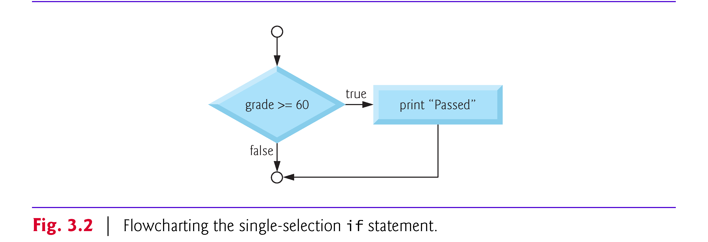
3.5 The if Selection Statement (Cont.)
The flowchart of Fig. 3.2 illustrates the single-selection if statement.
This flowchart contains what is perhaps the most important flowcharting symbol—the diamond symbol, also called the decision symbol, which indicates that a decision is to be made.
The decision symbol contains an expression, such as a condition, that can be either true or false.

Slide 23
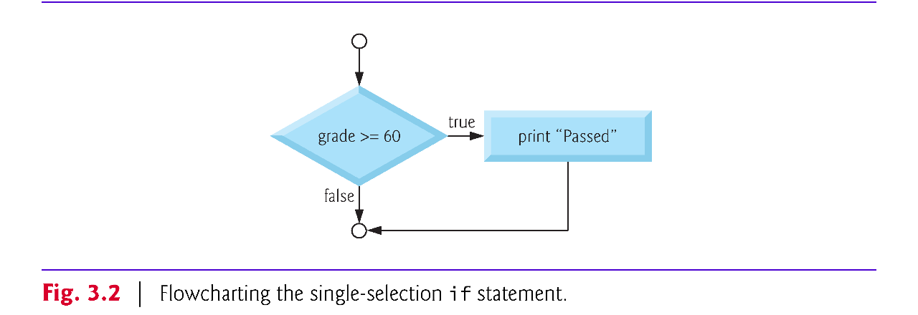
3.5 The if Selection Statement (Cont.)
The decision symbol has two flowlines emerging from it.
One indicates the direction to take when the expression in the symbol is true and the other the direction to take when the expression is false.
Decisions can be based on conditions containing relational or equality operators.
In fact, a decision can be based on any expression—if the expression evaluates to zero, it’s treated as false, and if it evaluates to nonzero, it’s treated as true.

Slide 24
3.6 The if…else Selection Statement
The if…else selection statement allows you to specify that different actions are to be performed when the condition is true and when it’s false.
For example, the pseudocode statement
If student’s grade is greater than or equal to 60 Print “Passed” else Print “Failed”
prints “Passed” if the student’s grade is greater than or equal to 60 and “Failed” if the student’s grade is less than 60.
In either case, after printing occurs, the next pseudocode statement in sequence is “performed”. The body of the else is also indented.

Slide 25
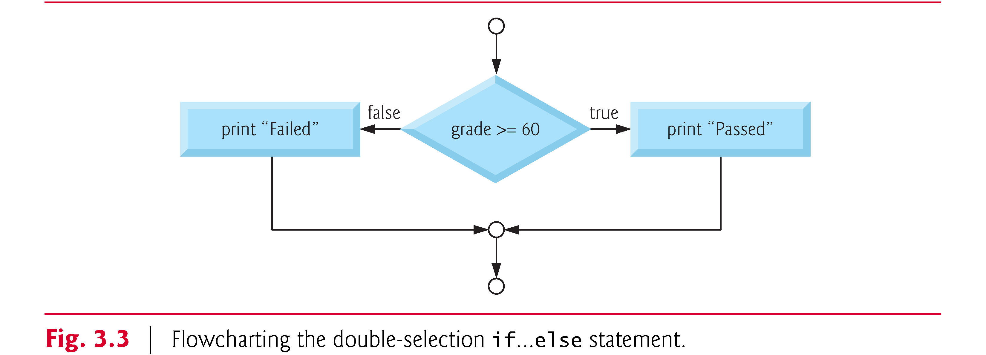
3.6 The if…else Selection Statement (Cont.)
The preceding pseudocode If…else statement may be written in C as
if ( grade >= 60 ) { printf( "Passed\n" ); } // end if else { printf( "Failed\n" ); } // end else
The flowchart is shown in Fig. 3.3. The only symbols are rectangles for actions and a diamond for a decision.

Slide 26
3.6 The if…else Selection Statement (Cont.)
C provides the conditional operator (?:) which is closely related to the if…else statement.
The conditional operator is C’s only ternary operator—it takes three operands.
These operands together with the conditional operator form a conditional expression.
The first operand is a condition.
The second operand is the value for the entire conditional expression if the condition is true and the operand is the value for the entire conditional expression if the condition is false.

Slide 27
3.6 The if…else Selection Statement (Cont.)
For example, the puts statement
puts( grade >= 60 ? "Passed" : "Failed" );
contains as its second argument a conditional expression that evaluates to the string "Passed" if the condition grade >= 60 is true and to the string "Failed" if the condition is false.
This puts statement performs in essentially the same way as the preceding if…else statement.

Slide 28
3.6 The if…else Selection Statement (Cont.)
The second and third operands in a conditional expression can also be actions to be executed.
For example, the conditional expression
grade >= 60 ? puts( "Passed" ) : puts( "Failed" );
is read
“If grade is greater than or equal to 60 then puts("Passed"), otherwise puts( "Failed" ).” This, too, is comparable to the preceding if…else statement.
We’ll see that conditional operators can be used in some places where if…else statements cannot.

Slide 29
3.6 The if…else Selection Statement
Nested if...else Statements
Nested if…else statements test for multiple cases by placing if…else statements inside if…else statements.
Following pseudocode will print A for grades greater than or equal to 90, B for grades greater than or equal to 80, C for grades greater than or equal to 70, D for grades greater than or equal to 60 and F for all other grades.
If student’s grade is greater than or equal to 90 Print “A” else If student’s grade is greater than or equal to 80 Print “B” else If student’s grade is greater than or equal to 70 Print “C” else If student’s grade is greater than or equal to 60 Print “D” else Print “F”

Slide 30
3.6 The if…else Selection Statement
This pseudocode may be written in C as
if ( grade >= 90 ) puts( "A" ); else if ( grade >= 80 ) puts("B"); else if ( grade >= 70 ) puts("C"); else if ( grade >= 60 ) puts( "D" ); else puts( "F" );
If the variable grade is greater than or equal to 90, all four conditions will be true, but only the puts statement after the first test will be executed.
After that puts is executed, the else part of the “outer” if…else statement is skipped.

Slide 31
3.6 The if…else Selection Statement (Cont.)
You may prefer to write the preceding if statement by using else if as:
if ( grade >= 90 ) puts( "A" ); else if ( grade >= 80 ) puts( "B" ); else if ( grade >= 70 ) puts( "C" ); else if ( grade >= 60 ) puts( "D" ); else puts( "F" );

Slide 32
3.6 The if…else Selection Statement (Cont.)
As far as the C compiler is concerned, both forms are equivalent.
The latter form is popular because it avoids the deep indentation of the code to the right.
This if selection statement expects only one statement in its body—if you have only one statement in the if’s body, you do not need the enclose it in braces.
To include several statements in the body of an if, you must enclose the set of statements in braces ({ and }).
A set of statements contained within a pair of braces is called a compound statement or a block.

Slide 33
3.6 The if…else Selection Statement
The following example includes a compound statement in the else part of an if…else statement.
if ( grade >= 60 ) { puts( "Passed. " ); } // end if else { puts( "Failed. " ); puts( "You must take this course again. " ); } // end else
In this case, if grade is less than 60, the program executes both puts statements in the body of the else and prints
Failed.
You must take this course again.
The braces surrounding the two statements in the else are important. Without them, the statement
puts( "You must take this course again." );
would be outside the body of the else part of the if and would execute regardless of whether the grade was less than 60.

Slide 34
3.6 The if…else Selection Statement (Cont.)
A syntax error is caught by the compiler.
A logic error has its effect at execution time.
A fatal logic error causes a program to fail and terminate prematurely.
A nonfatal logic error allows a program to continue executing but to produce incorrect results.
Just as a compound statement can be placed anywhere a single statement can be placed, it’s also possible to have no statement at all, i.e., the empty statement.
The empty statement is represented by placing a semicolon (;) where a statement would normally be.

Slide 35
3.7 The while Iteration Statement
An iteration statement allows you to specify that an action is to be repeated while some condition remains true.
The pseudocode statement
While there are more items on my shopping list Purchase next item and cross it off my list
describes the iteration that occurs during a shopping trip.
The condition, “there are more items on my shopping list” may be true or false.
If it’s true, then the action, “Purchase next item and cross it off my list” is performed.
This action will be performed repeatedly while the condition remains true.

Slide 36
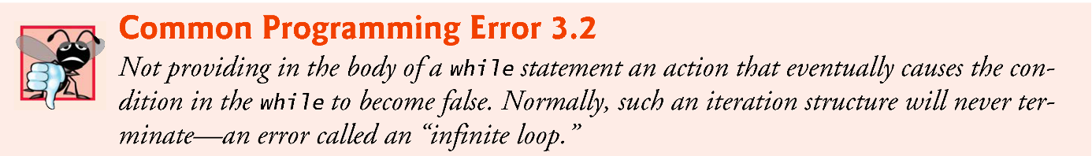
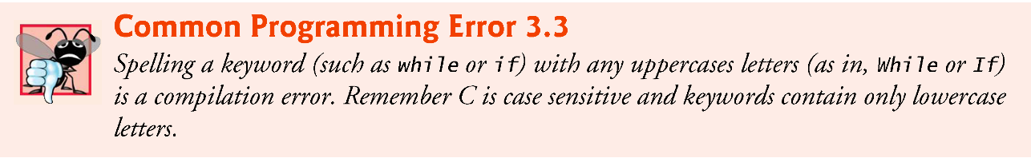
3.7 The while Iteration Statement (Cont.)
The statements contained in the while iteration statement constitute the body of the while.
The while statement body may be a single statement or a compound statement.
Eventually, the condition will become false (when the last item on the shopping list has been purchased and crossed off the list).
At this point, the iteration terminates, and the first pseudocode statement after the iteration structure is executed.

Slide 37
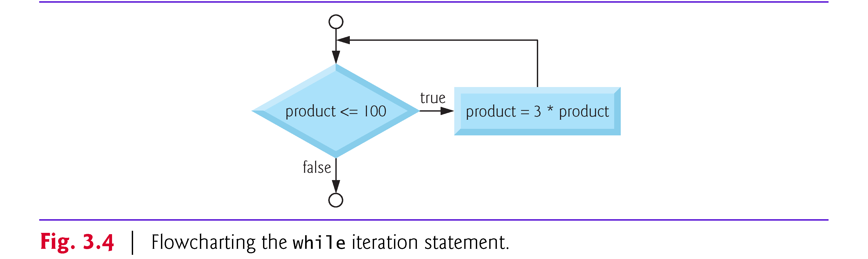
3.7 The while Iteration Statement (Cont.)
As an example of a while statement, consider a program segment designed to find the first power of 3 larger than 100.
Suppose the integer variable product has been initialized to 3.
When the following while iteration statement finishes executing, product will contain the desired answer:
product = 3;
while ( product <= 100 ) { product = 3 * product; } // end while
Fig. 3.4 illustrates the flowchart in the while statement.

Slide 38
3.7 The while Iteration Statement (Cont.)
When the while statement is entered, value of product is 3.
The variable product is repeatedly multiplied by 3, taking on the values 9, 27 and 81 successively.
When product becomes 243, the condition in the while statement, product <= 100, becomes false.
This terminates the iteration, and the final value of product is 243.
Program execution continues with the next statement after the while.

Slide 39
3.8 Formulating Algorithms Case Study 1: Counter-Controlled Iteration
To illustrate how algorithms are developed, we solve several variations of a class-average problem.
Consider the following problem statement:
A class of ten students took a quiz. The grades (integers in the range 0 to 100) for this quiz are available to you. Determine the class average on the quiz.
The class average is equal to the sum of the grades divided by the number of students.
The algorithm for solving this problem on a computer must input each of the grades, perform the average calculation, and print the result.

Slide 40
3.8 Formulating Algorithms Case Study 1: Counter-Controlled Iteration (Cont.)
Let’s use pseudocode to list the actions to execute and specify the order in which these actions should execute.
We use counter-controlled iteration to input the grades one at a time.
This technique uses a variable called a counter to specify the number of times a set of statements should execute.
In this example, iteration terminates when the counter exceeds 10.

Slide 41
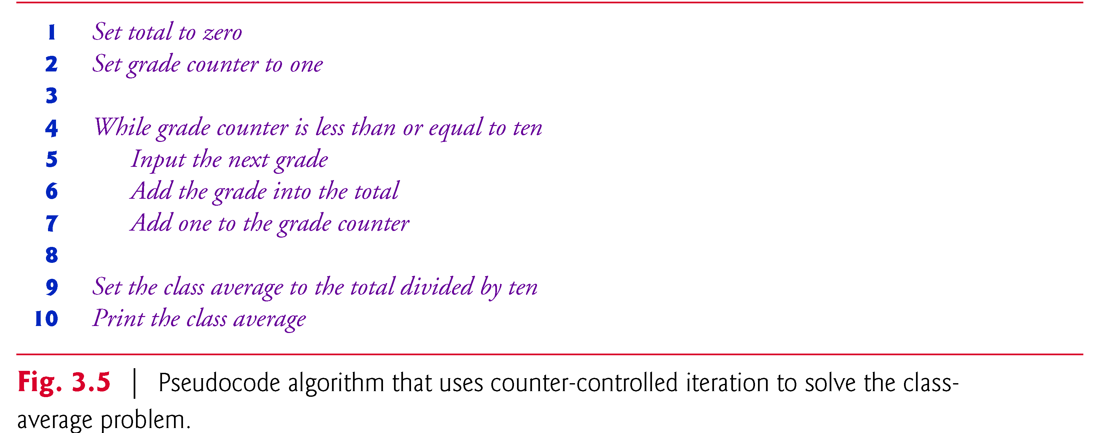
3.8 Formulating Algorithms Case Study 1: Counter-Controlled Iteration (Cont.)
Fig. 3.5 shows pseudocode
Counter-controlled iteration is often called definite iteration because the number of iterations is known before the loop begins executing.

Slide 42
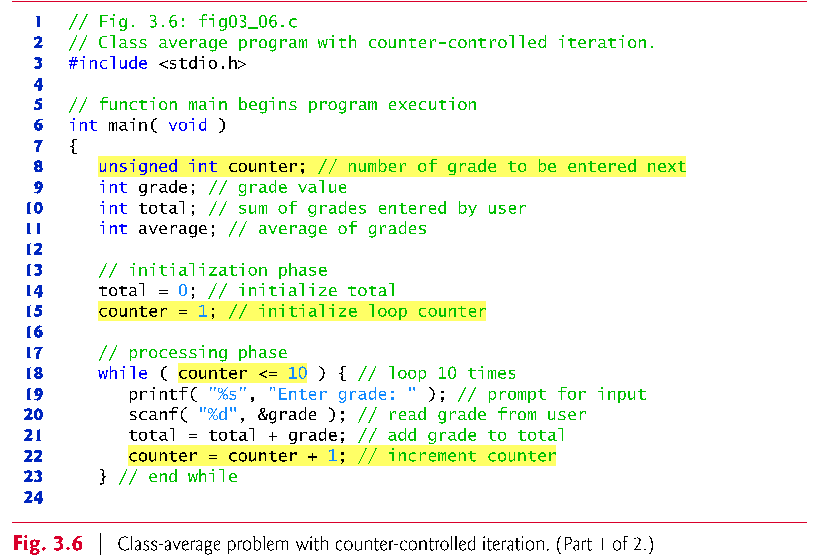
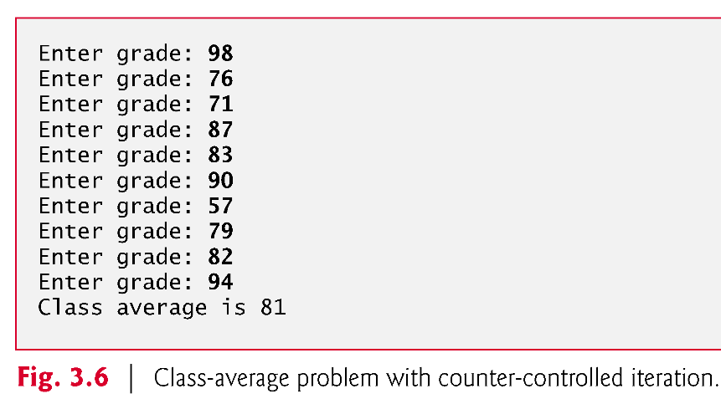
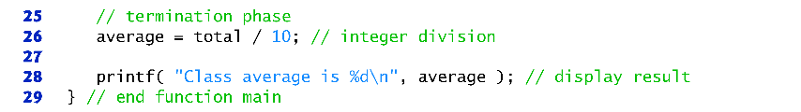
3.8 Formulating Algorithms Case Study 1: Counter-Controlled Iteration (Cont.)
Fig. 3.6 shows the corresponding C program

Slide 43
3.8 Formulating Algorithms Case Study 1: Counter-Controlled Iteration (Cont.)
The algorithm mentions a total and a counter.
A total is a variable used to accumulate the sum of a series of values.
A counter is a variable used to count the number of grades entered.
Because the counter variable is used to count from 1 to 10 in this program (all positive values), we declared the variable as an unsigned int, which can store only non-negative values (that is, 0 and higher).

Slide 44
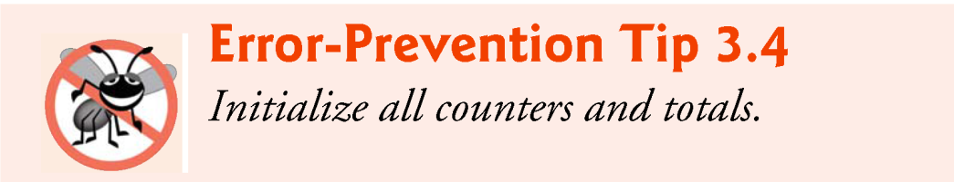
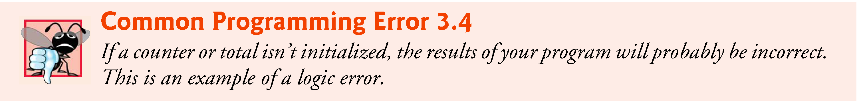
3.8 Formulating Algorithms Case Study 1: Counter-Controlled Iteration (Cont.)
Variables used to store totals should be initialized to zero before being used in a program; otherwise the sum would include the previous value stored in the total’s memory location.
Counter variables are normally initialized to zero or one, depending on their use.
An uninitialized variable contains a “garbage” value—the value last stored in the memory location reserved for that variable.

Slide 45
3.9 Formulating Algorithms with Top-Down, Stepwise Refinement Case Study 2: Sentinel-Controlled Iteration
Let’s generalize the class-average problem.
Consider the following problem:
Develop a class-average program that will process an arbitrary number of grades each time the program is run.
In the first class-average example, the number of grades (10) was known in advance.
In this example, the program must process an arbitrary number of grades.
How can the program determine when to stop the input of grades? How will it know when to calculate and print the class average?

Slide 46
3.9 Formulating Algorithms with Top-Down, Stepwise Refinement Case Study 2: Sentinel-Controlled Iteration (Cont.)
One way to solve this problem is to use a special value called a sentinel value to indicate “end of data entry.”
The user types in grades until all legitimate grades have been entered.
The user then types the sentinel value to indicate “the last grade has been entered.”
Sentinel-controlled iteration is often called indefinite iteration because the number of iterations isn’t known before the loop begins executing.

Slide 47
3.9 Formulating Algorithms with Top-Down, Stepwise Refinement Case Study 2: Sentinel-Controlled Iteration (Cont.)
Clearly, the sentinel value must be chosen so that it cannot be confused with an acceptable input value.
Because grades on a quiz are normally nonnegative integers, –1 is an acceptable sentinel value for this problem.
Thus, a run of the class-average program might process a stream of inputs such as 95, 96, 75, 74, 89 and –1.
The program would then compute and print the class average for the grades 95, 96, 75, 74, and 89 (–1 is the sentinel value, so it should not enter into the average calculation).

Slide 48
3.9 Formulating Algorithms with Top-Down, Stepwise Refinement Case Study 2: Sentinel-Controlled Iteration (Cont.)
Top-Down, Stepwise Refinement
We approach the class-average program with a technique called top-down, stepwise refinement, a technique that is essential to the development of well-structured programs.
We begin with a pseudocode representation of the top:
Determine the class average for the quiz
The top is a single statement that conveys the program’s overall function.
The top is a complete representation of a program.

Slide 49
3.9 Formulating Algorithms with Top-Down, Stepwise Refinement Case Study 2: Sentinel-Controlled Iteration (Cont.)
Unfortunately, the top rarely conveys a sufficient amount of detail for writing the C program.
So we now begin the refinement process.
We divide the top into a series of smaller tasks and list these in the order in which they need to be performed.
First Refinement
This results in the following first refinement:
Initialize variables Input, sum, and count the quiz grades Calculate and print the class average
Here, only the sequence structure has been used—the steps listed are to be executed in order, one after the other.

Slide 50
3.9 Formulating Algorithms with Top-Down, Stepwise Refinement Case Study 2: Sentinel-Controlled Iteration (Cont.)
Second Refinement
To proceed to the next level of refinement, i.e., the second refinement, we commit to specific variables.
We need a running total of the numbers, a count of how many numbers have been processed, a variable to receive the value of each grade as it’s input and a variable to hold the calculated average.
The pseudocode statement:
Initialize variables
may be refined as follows:
Initialize total to zero Initialize counter to zero

Slide 51
3.9 Formulating Algorithms with Top-Down, Stepwise Refinement Case Study 2: Sentinel-Controlled Iteration (Cont.)
Only the total and counter need to be initialized; the variables average and grade need not be initialized because their values will be written over by the process of destructive.
The pseudocode statement
Input, sum, and count the quiz grades
requires an iteration structure that successively inputs each grade.
Because we do not know in advance how many grades are to be processed, we’ll use sentinel-controlled iteration.

Slide 52
3.9 Formulating Algorithms with Top-Down, Stepwise Refinement Case Study 2: Sentinel-Controlled Iteration (Cont.)
The user will enter legitimate grades in one at a time.
After the last legitimate grade is typed, the user will type the sentinel value.
The program will test for this value after each grade is input and will terminate the loop when the sentinel is entered.
The refinement of the preceding pseudocode statement is then
Input the first grade While the user has not as yet entered the sentinel Add this grade into the running total Add one to the grade counter Input the next grade (possibly the sentinel)

Slide 53
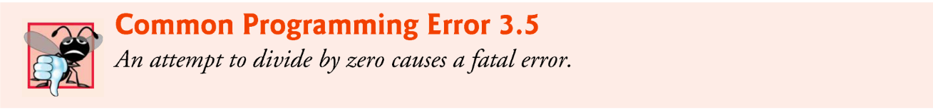
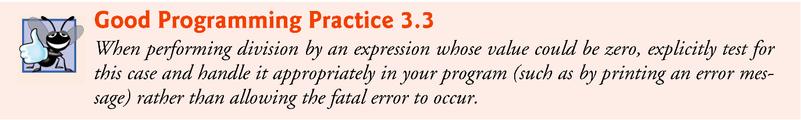
3.9 Formulating Algorithms with Top-Down, Stepwise Refinement Case Study 2: Sentinel-Controlled Iteration (Cont.)
The pseudocode statement
Calculate and print the class average
may be refined as follows:
If the counter is not equal to zero Set the average to the total divided by the counter Print the average else Print “No grades were entered”
Notice that we’re being careful here to test for the possibility of division by zero—a fatal error that if undetected would cause the program to fail (often called “crashing”).

Slide 54
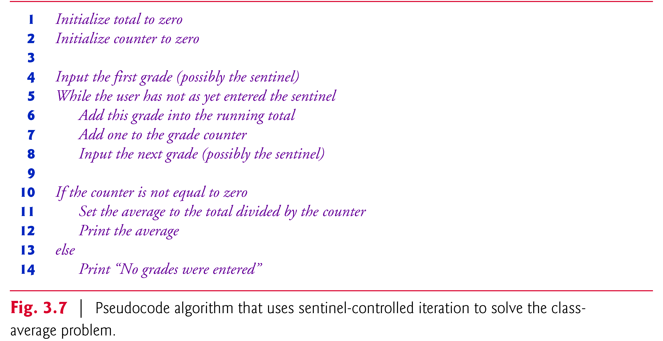
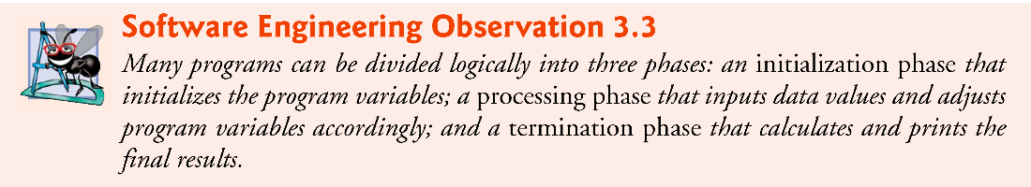
3.9 Formulating Algorithms with Top-Down, Stepwise Refinement Case Study 2: Sentinel-Controlled Iteration (Cont.)
The complete second refinement is shown in Fig. 3.7.

Slide 55

3.9 Formulating Algorithms with Top-Down, Stepwise Refinement Case Study 2: Sentinel-Controlled Iteration (Cont.)
The C program is shown in Fig. 3.8 after only two levels of refinement in the pseudocode algorithm.
Although only integer grades are entered, the average calculation is likely to produce a number with a decimal point.
The type int cannot represent such a number.
The program introduces the data type float to handle numbers with decimal points (called floating-point numbers) and introduces a special operator called a cast operator to handle the average calculation.
These features are explained after the program is presented.

Slide 56
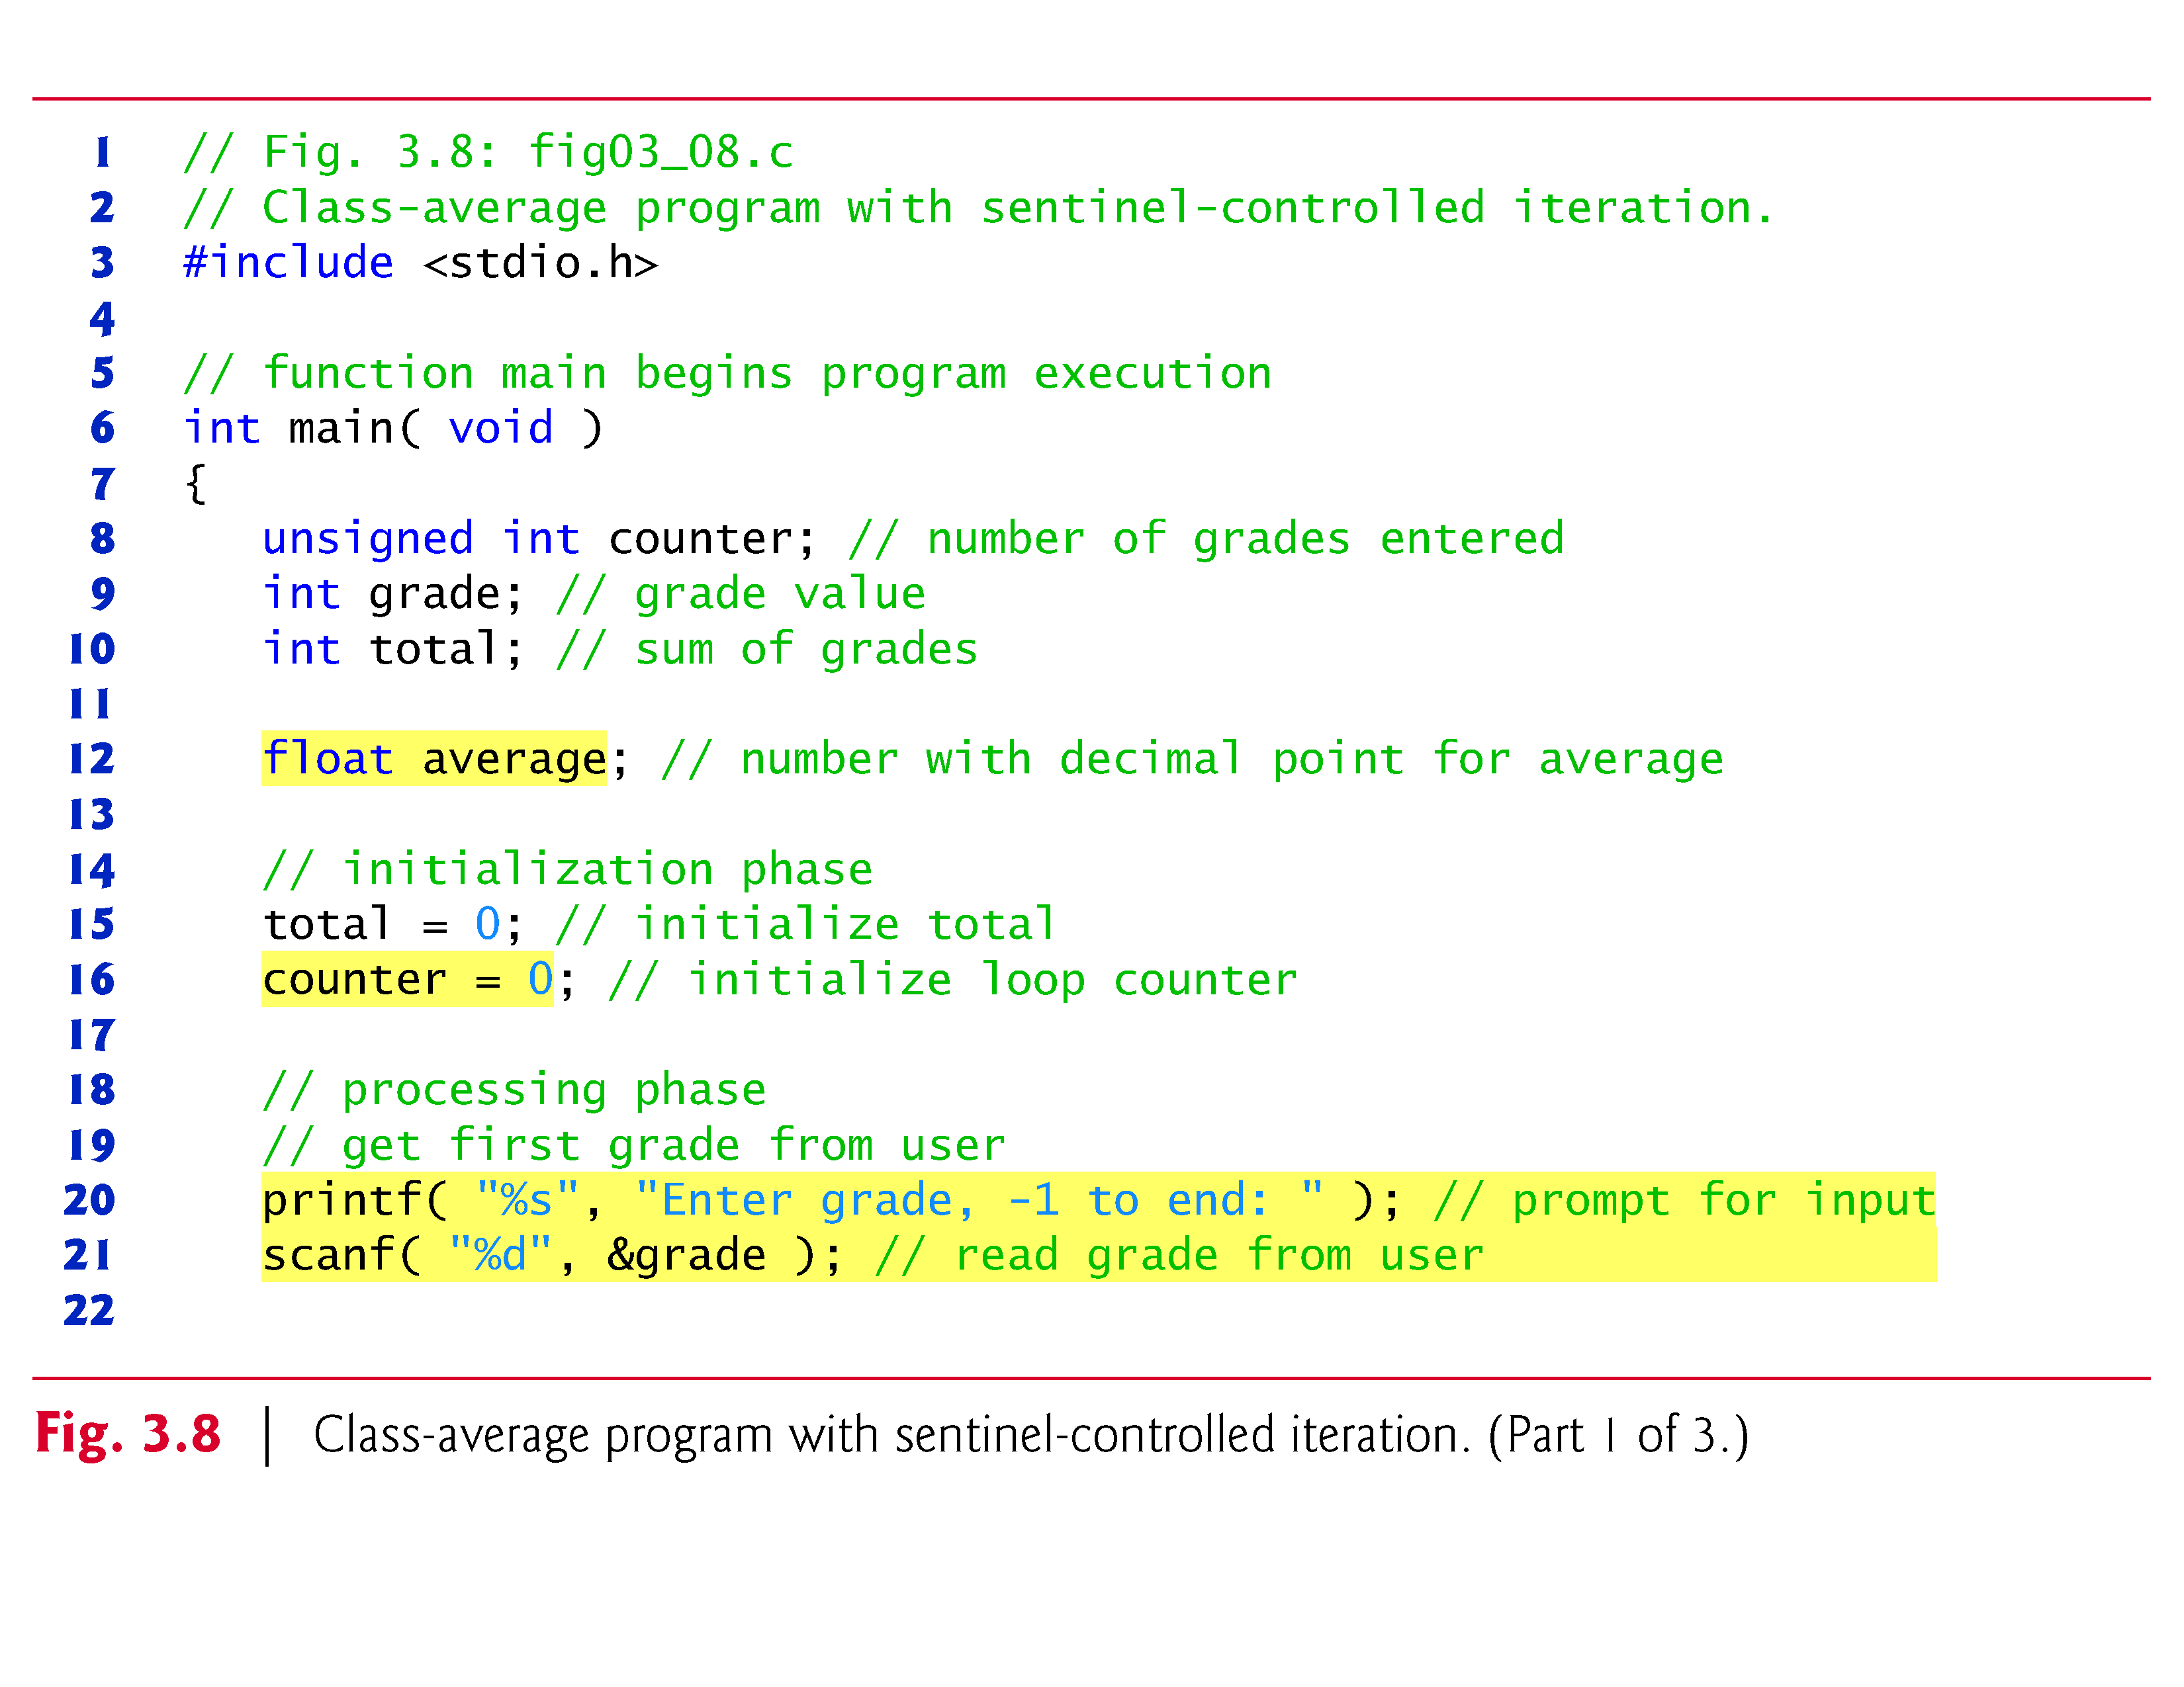

Slide 57
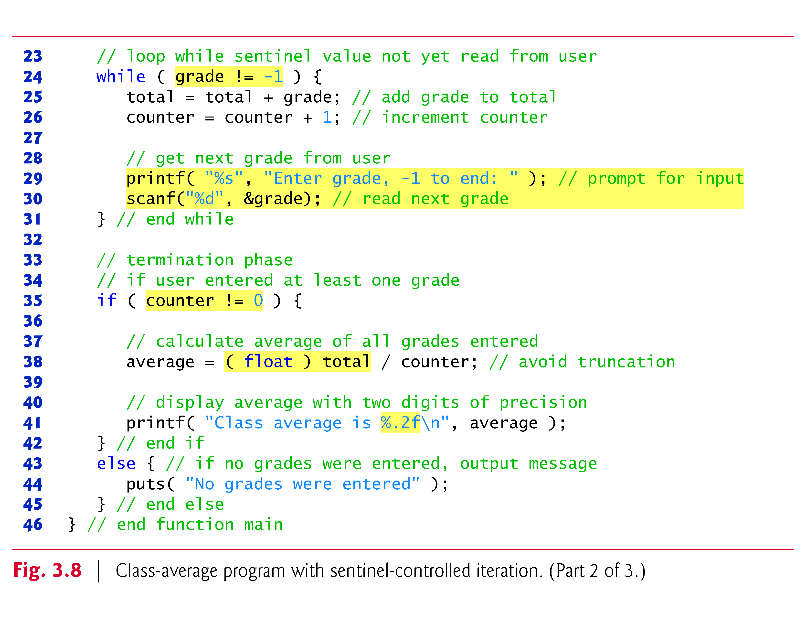

Slide 58
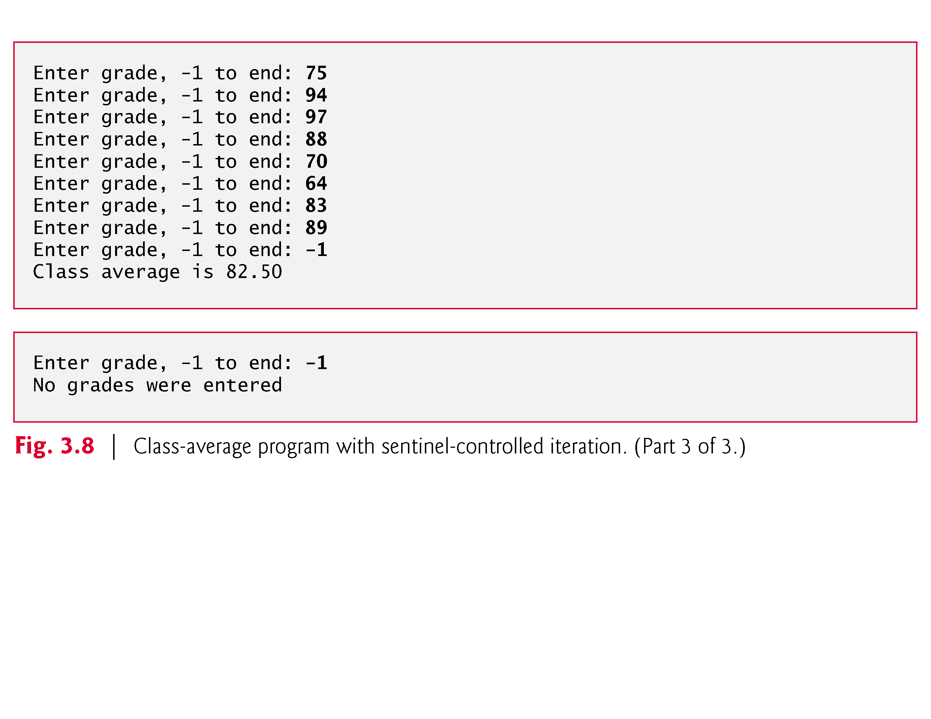

Slide 59
3.9 Formulating Algorithms with Top-Down, Stepwise Refinement Case Study 2: Sentinel-Controlled Iteration (Cont.)
In the while loop in Fig. 3.8, the braces are necessary to ensure that all four statements execute within the loop.
Without the braces, the last three statements in the body of the loop would fall outside the loop, causing the computer to interpret this code incorrectly as follows.
while ( grade != -1 ) total = total + grade; // add grade to total counter = counter + 1; // increment counter printf( "Enter grade, -1 to end: " ); // prompt for input scanf( "%d", &grade ); // read next grade
This would cause an infinite loop if -1 is not input as the first grade.

Slide 60
3.9 Formulating Algorithms with Top-Down, Stepwise Refinement Case Study 2: Sentinel-Controlled Iteration (Cont.)
Converting Between Types Explicitly and Implicitly
Averages do not always evaluate to integer values.
Often, an average is a value such as 7.2 or –93.5 that contains a fractional part.
These values are referred to as floating-point numbers and can be represented by the data type float.
The variable average is defined to be of type float to capture the fractional result of our calculation.
However, the result of the calculation total / counter is an integer because total and counter are both integer variables.

Slide 61
3.9 Formulating Algorithms with Top-Down, Stepwise Refinement Case Study 2: Sentinel-Controlled Iteration (Cont.)
Dividing two integers results in integer division in which any fractional part of the calculation is truncated (i.e., lost).
Because the calculation is performed first, the fractional part is lost before the result is assigned to average.
To produce a floating-point calculation with integer values, we must create temporary values that are floating-point numbers.
C provides the unary cast operator to accomplish this task.

Slide 62
3.9 Formulating Algorithms with Top-Down, Stepwise Refinement Case Study 2: Sentinel-Controlled Iteration (Cont.)
Line 38
average = ( float ) total / counter;
includes the cast operator (float), which creates a temporary floating-point copy of its operand, total.
The value stored in total is still an integer.
Using a cast operator in this manner is called explicit conversion.
The calculation now consists of a floating-point value (the temporary float version of total) divided by the unsigned int value stored in counter.

Slide 63
3.9 Formulating Algorithms with Top-Down, Stepwise Refinement Case Study 2: Sentinel-Controlled Iteration (Cont.)
C evaluates arithmetic expressions only in which the data types of the operands are identical.
To ensure that the operands are of the same type, the compiler performs an operation called implicit conversion on selected operands.
For example, in an expression containing the data types unsigned int and float, copies of unsigned int operands are made and converted to float.
In our example, after a copy of counter is made and converted to float, the calculation is performed and the result of the floating-point division is assigned to average.
average = ( float ) total / counter;

Slide 64
3.9 Formulating Algorithms with Top-Down, Stepwise Refinement Case Study 2: Sentinel-Controlled Iteration (Cont.)
C provides a set of rules for convertion of operands of different types.
We discuss this further in Chapter 5.
Cast operators are available for most data types—they’re formed by placing parentheses around a type name.
Each cast operator is a unary operator, i.e., an operator that takes only one operand.
C also supports unary versions of the plus (+) and minus (-) operators, so you can write expressions such as -7 or +5.
Cast operators associate from right to left and have the same precedence as other unary operators such as unary + and unary -.
This precedence is one level higher than that of the multiplicative operators *, / and %.

Slide 65
3.9 Formulating Algorithms with Top-Down, Stepwise Refinement Case Study 2: Sentinel-Controlled Iteration (Cont.)
Formatting Floating-Point Numbers
Figure 3.8 uses the printf conversion specifier %.2f to print the value of average.
The f specifies that a floating-point value will be printed.
The .2 is the precision with which the value will be displayed—with 2 digits to the right of the decimal point.

Slide 66
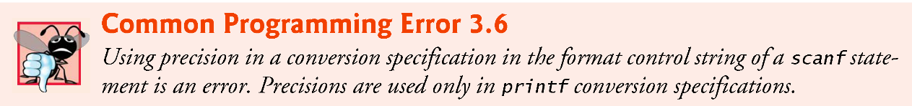
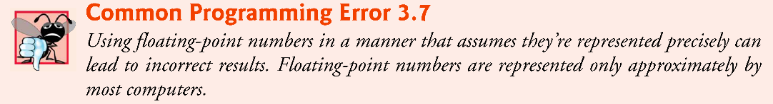
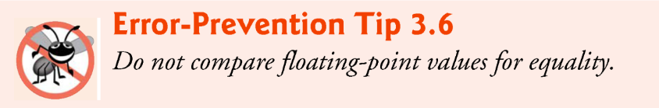
3.9 Formulating Algorithms with Top-Down, Stepwise Refinement Case Study 2: Sentinel-Controlled Iteration (Cont.)
If the %f conversion specifier is used (without specifying the precision), the default precision of 6 is used—exactly as if the conversion specifier %.6f had been used.
When floating-point values are printed with precision, the printed value is rounded to the indicated number of decimal positions.
The value in memory is unaltered.
When the following statements are executed, the values 3.45 and 3.4 are printed.
printf( "%.2f\n", 3.446 ); // prints 3.45 printf( "%.1f\n", 3.446 ); // prints 3.4

Slide 67
3.10 Formulating Algorithms with Top-Down, Stepwise Refinement Case Study 3: Nested Control Statements
Let’s work another complete problem.
We’ll once again formulate the algorithm using pseudocode and top-down, stepwise refinement, and write a corresponding C program.
We’ve seen that control statements may be stacked on top of one another (in sequence) just as a child stacks building blocks.
In this case study we’ll see the only other structured way control statements may be connected in C, namely through nesting of one control statement within another.

Slide 68
3.10 Formulating Algorithms with Top-Down, Stepwise Refinement Case Study 3: Nested Control Statements (Cont.)
Consider the following problem statement:
A college offers a course that prepares students for the state licensing exam for real estate brokers.
Last year, 10 of the students who completed this course took the licensing examination.
Naturally, the college wants to know how well its students did on the exam.
You’ve been asked to write a program to summarize the results. You’ve been given a list of these 10 students.
Next to each name a 1 is written if the student passed the exam and a 2 if the student failed.

Slide 69
3.10 Formulating Algorithms with Top-Down, Stepwise Refinement Case Study 3: Nested Control Statements (Cont.)
Your program should analyze the results of the exam as follows:
Input each test result (i.e., a 1 or a 2). Display the prompting message “Enter result” each time the program requests another test result.
Count the number of test results of each type.
Display a summary of the test results indicating the number of students who passed and the number who failed.
If more than eight students passed the exam, print the message “Bonus to instructor!”

Slide 70
3.10 Formulating Algorithms with Top-Down, Stepwise Refinement Case Study 3: Nested Control Statements (Cont.)
After reading the problem statement carefully, we make the following observations:
The program must process 10 test results. A counter-controlled loop will be used.
Each test result is a number—either a 1 or a 2. Each time the program reads a test result, the program must determine whether the number is a 1 or a 2. We test for a 1 in our algorithm. If the number is not a 1, we assume that it’s a 2.
Two counters are used—one to count the number of students who passed the exam and one to count the number of students who failed the exam.
After the program has processed all the results, it must decide whether more than 8 students passed the exam.

Slide 71
3.10 Formulating Algorithms with Top-Down, Stepwise Refinement Case Study 3: Nested Control Statements (Cont.)
Let’s proceed with top-down, stepwise refinement.
We begin with a pseudocode representation of the top:
Analyze exam results and decide if instructor should receive a bonus
Once again, it’s important to emphasize that the top is a complete representation of the program, but several refinements are likely to be needed before the pseudocode can be naturally evolved into a C program.

Slide 72
3.10 Formulating Algorithms with Top-Down, Stepwise Refinement Case Study 3: Nested Control Statements (Cont.)
Our first refinement is
Initialize variables Input the ten quiz grades and count passes and failures Print a summary of the exam results and decide if instructor should receive a bonus
Here, too, even though we have a complete representation of the entire program, further refinement is necessary.
We now commit to specific variables.
Counters are needed to record the passes and failures, a counter will be used to control the looping process, and a variable is needed to store the user input.

Slide 73
3.10 Formulating Algorithms with Top-Down, Stepwise Refinement Case Study 3: Nested Control Statements (Cont.)
The pseudocode statement
Initialize variables
may be refined as follows:
Initialize passes to zero Initialize failures to zero Initialize student to one
Notice that only the counters and totals are initialized.
The pseudocode statement
Input the ten quiz grades and count passes and failures
requires a loop that successively inputs the result of each exam.

Slide 74
3.10 Formulating Algorithms with Top-Down, Stepwise Refinement Case Study 3: Nested Control Statements (Cont.)
Here it’s known in advance that there are precisely ten exam results, so counter-controlled looping is appropriate.
Inside the loop (i.e., nested within the loop) a double-selection statement will determine whether each exam result is a pass or a failure and will increment the appropriate counters accordingly.

Slide 75
3.10 Formulating Algorithms with Top-Down, Stepwise Refinement Case Study 3: Nested Control Statements (Cont.)
The refinement of the preceding pseudocode statement is then
While student counter is less than or equal to ten Input the next exam result If the student passed Add one to passes else Add one to failures Add one to student counter
The pseudocode statement
Print a summary of the exam results and decide if instructor should receive a bonus
may be refined as follows:
Print the number of passes Print the number of failures If more than eight students passed Print “Bonus to instructor!”

Slide 76
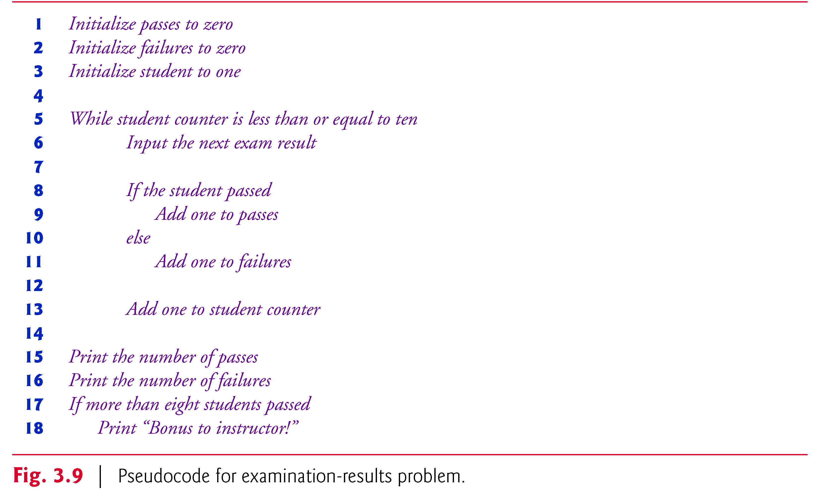
3.10 Formulating Algorithms with Top-Down, Stepwise Refinement Case Study 3: Nested Control Statements (Cont.)
The complete second refinement appears in Fig. 3.9.

Slide 77
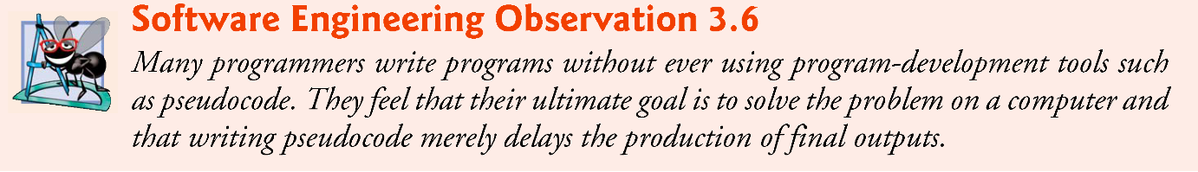
3.10 Formulating Algorithms with Top-Down, Stepwise Refinement Case Study 3: Nested Control Statements (Cont.)
This pseudocode is now sufficiently refined for conversion to C.
The C program and two sample executions are shown in Fig. 3.10.
We’ve taken advantage of a feature of C that allows initialization to be incorporated into definitions.
Such initialization occurs at compile time.
Also, notice that when you output an unsigned int you use the %u conversion specifier.

Slide 78
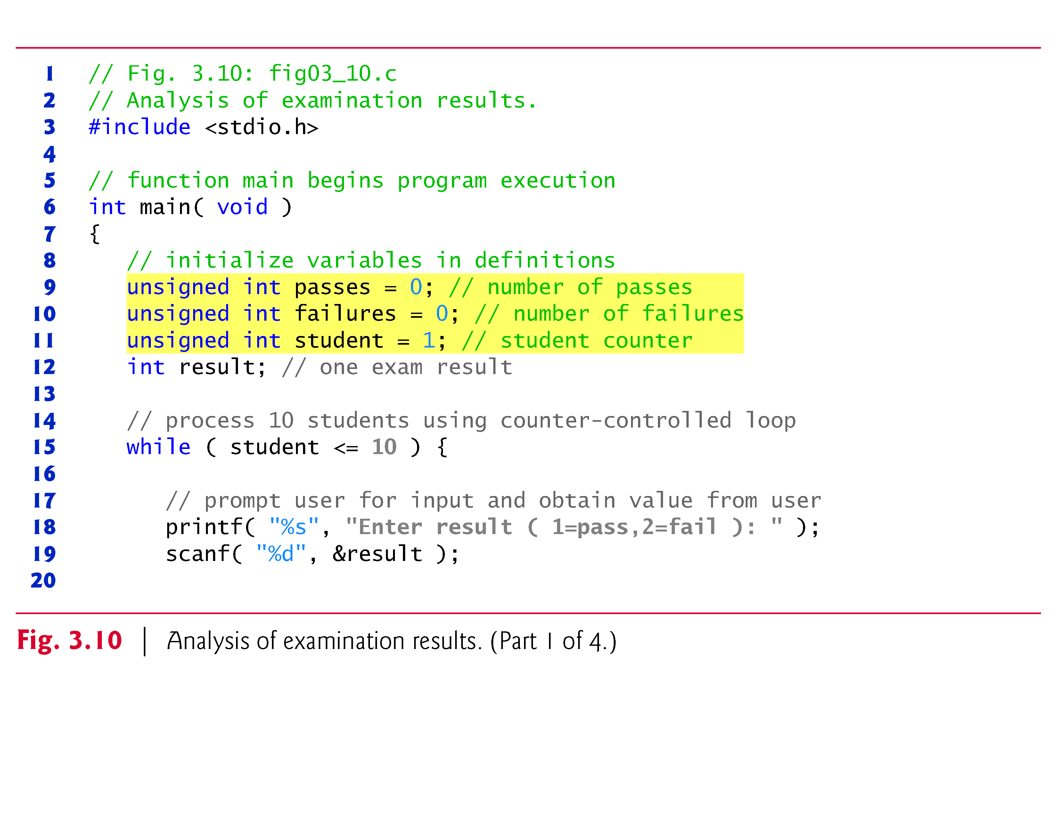

Slide 79
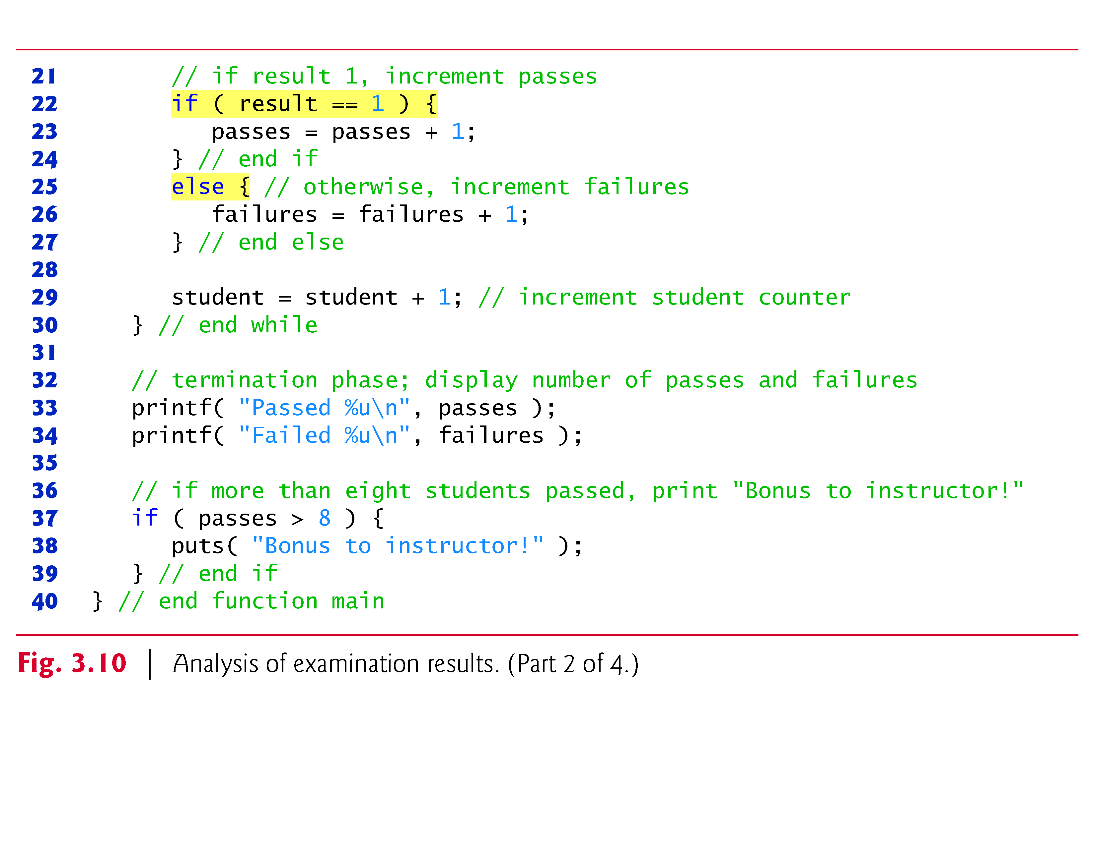

Slide 80
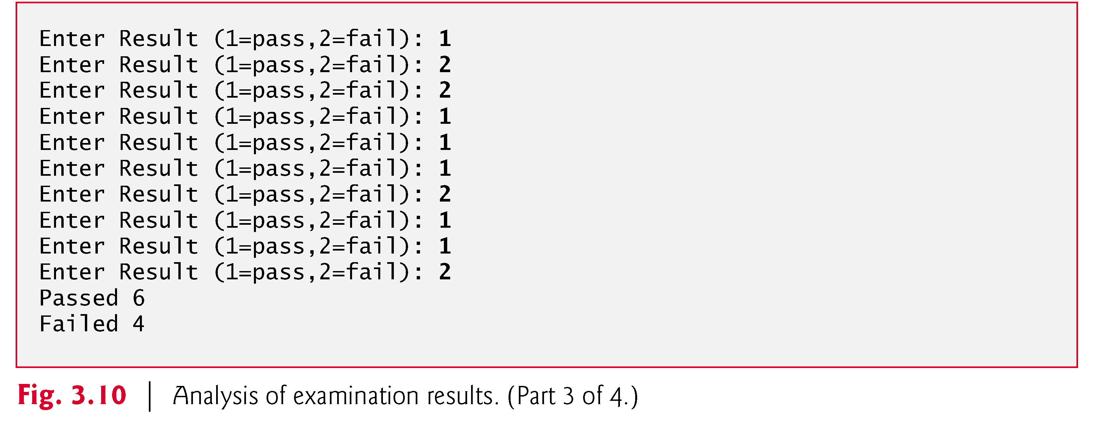
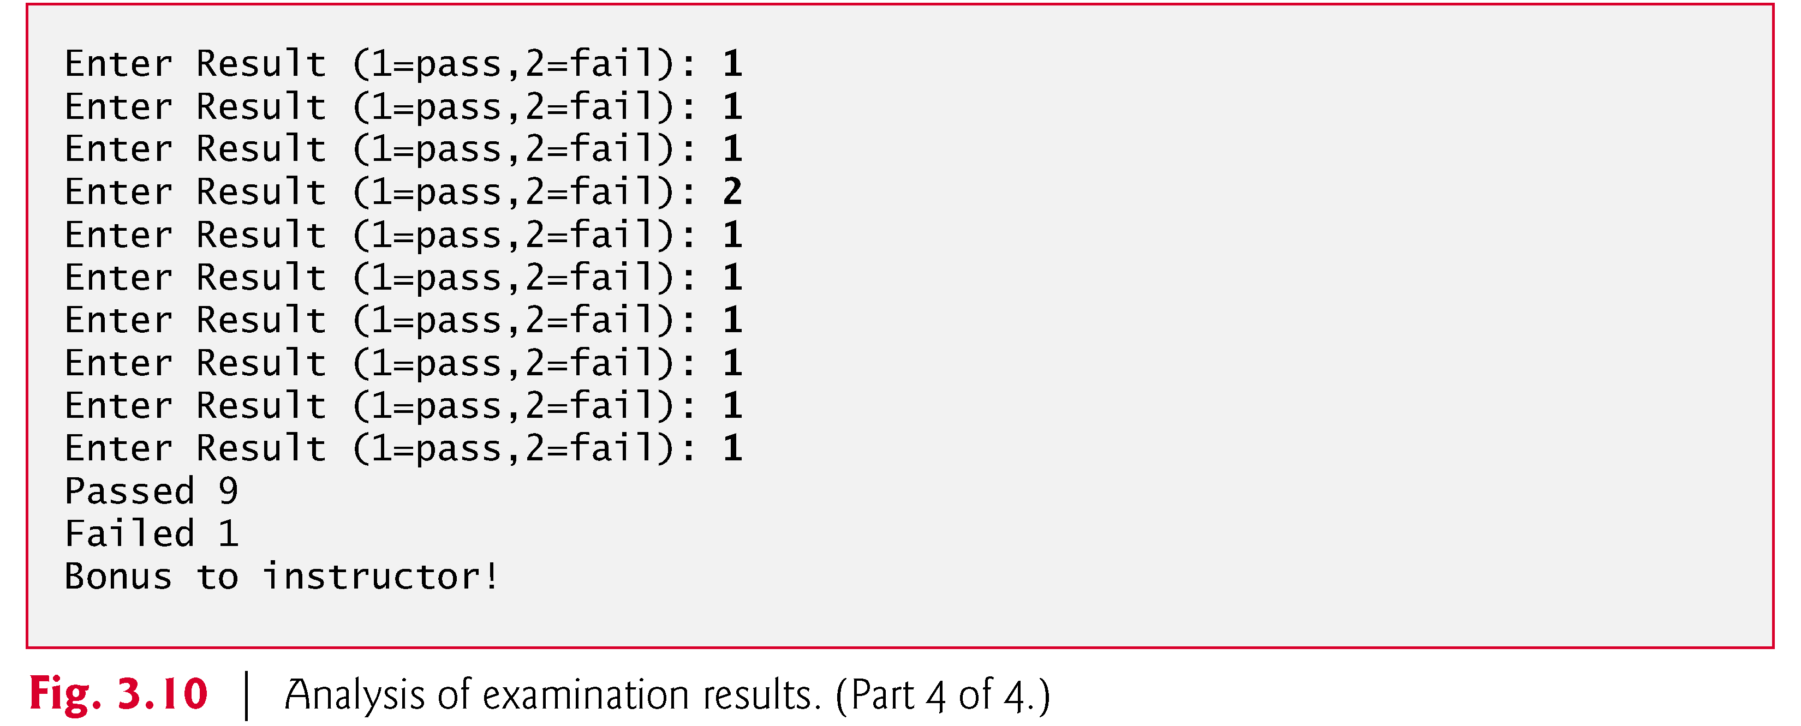

Slide 81
3.11 Assignment Operators
C provides several assignment operators for abbreviating assignment expressions.
For example, the statement
c = c + 3;
can be abbreviated with the addition assignment operator += as
c += 3;
The += operator adds the value of the expression on the right of the operator to the value of the variable on the left of the operator and stores the result in the variable on the left of the operator.

Slide 82
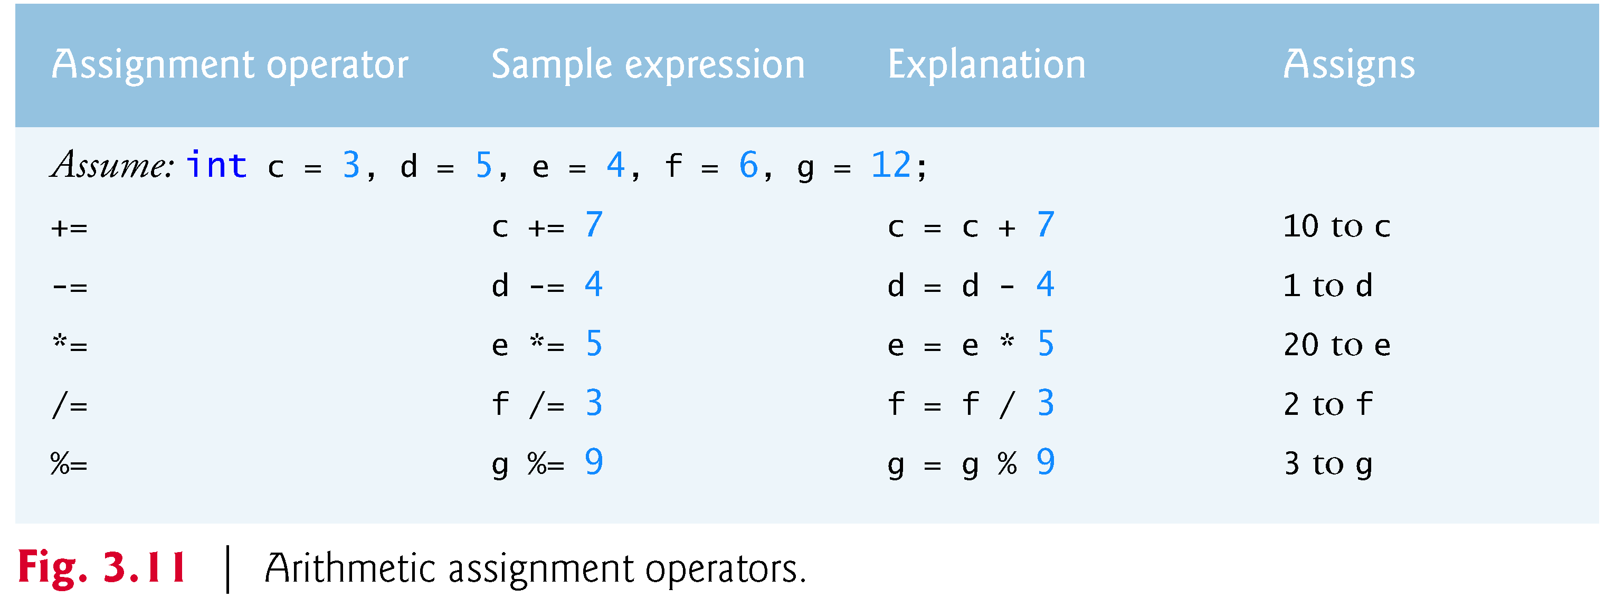
3.11 Assignment Operators (Cont.)
Any statement of the form
variable = variable operator expression;
where operator is one of the binary operators +, -, *, / or % can be written in the form
variable operator= expression;
Thus the assignment c += 3 adds 3 to c.
Figure 3.11 shows the arithmetic assignment operators, sample expressions using these operators and explanations.

Slide 83
3.12 Increment and Decrement Operators
C also provides the unary increment operator, ++, and the unary decrement operator, --, which are summarized in Fig. 3.12.
If a variable c is to be incremented by 1, the increment operator ++ can be used rather than the expressions c = c + 1 or c += 1.
If increment or decrement operators are placed before a variable (i.e., prefixed), they’re referred to as the preincrement or predecrement operators, respectively.
If increment or decrement operators are placed after a variable (i.e., postfixed), they’re referred to as the postincrement or postdecrement operators, respectively.

Slide 84
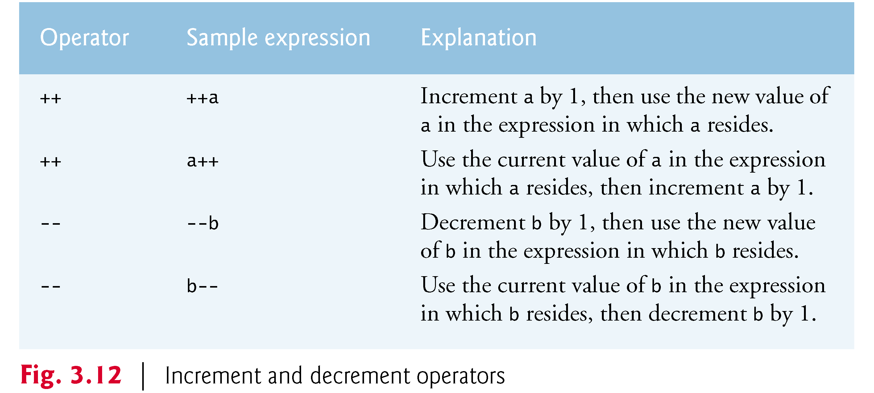
3.12 Increment and Decrement Operators (Cont.)
Preincrementing (predecrementing) a variable causes the variable to be incremented (decremented) by 1, then the new value of the variable is used in the expression in which it appears.
Postincrementing (postdecrementing) the variable causes the current value of the variable to be used in the expression in which it appears, then the variable value is incremented (decremented) by 1.

Slide 85
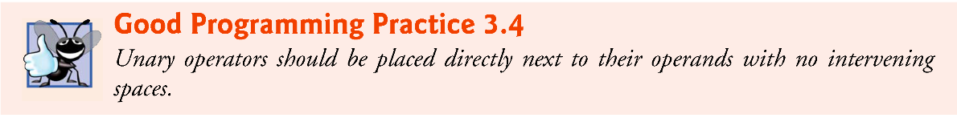
3.12 Increment and Decrement Operators (Cont.)
Figure 3.13 demonstrates the difference between the preincrementing and the postincrementing versions of the ++ operator.
Postincrementing the variable c causes it to be incremented after it’s used in the printf statement.
Preincrementing the variable c causes it to be incremented before it’s used in the printf statement.
The program displays the value of c before and after the ++ operator is used.
The decrement operator (--) works similarly.

Slide 86
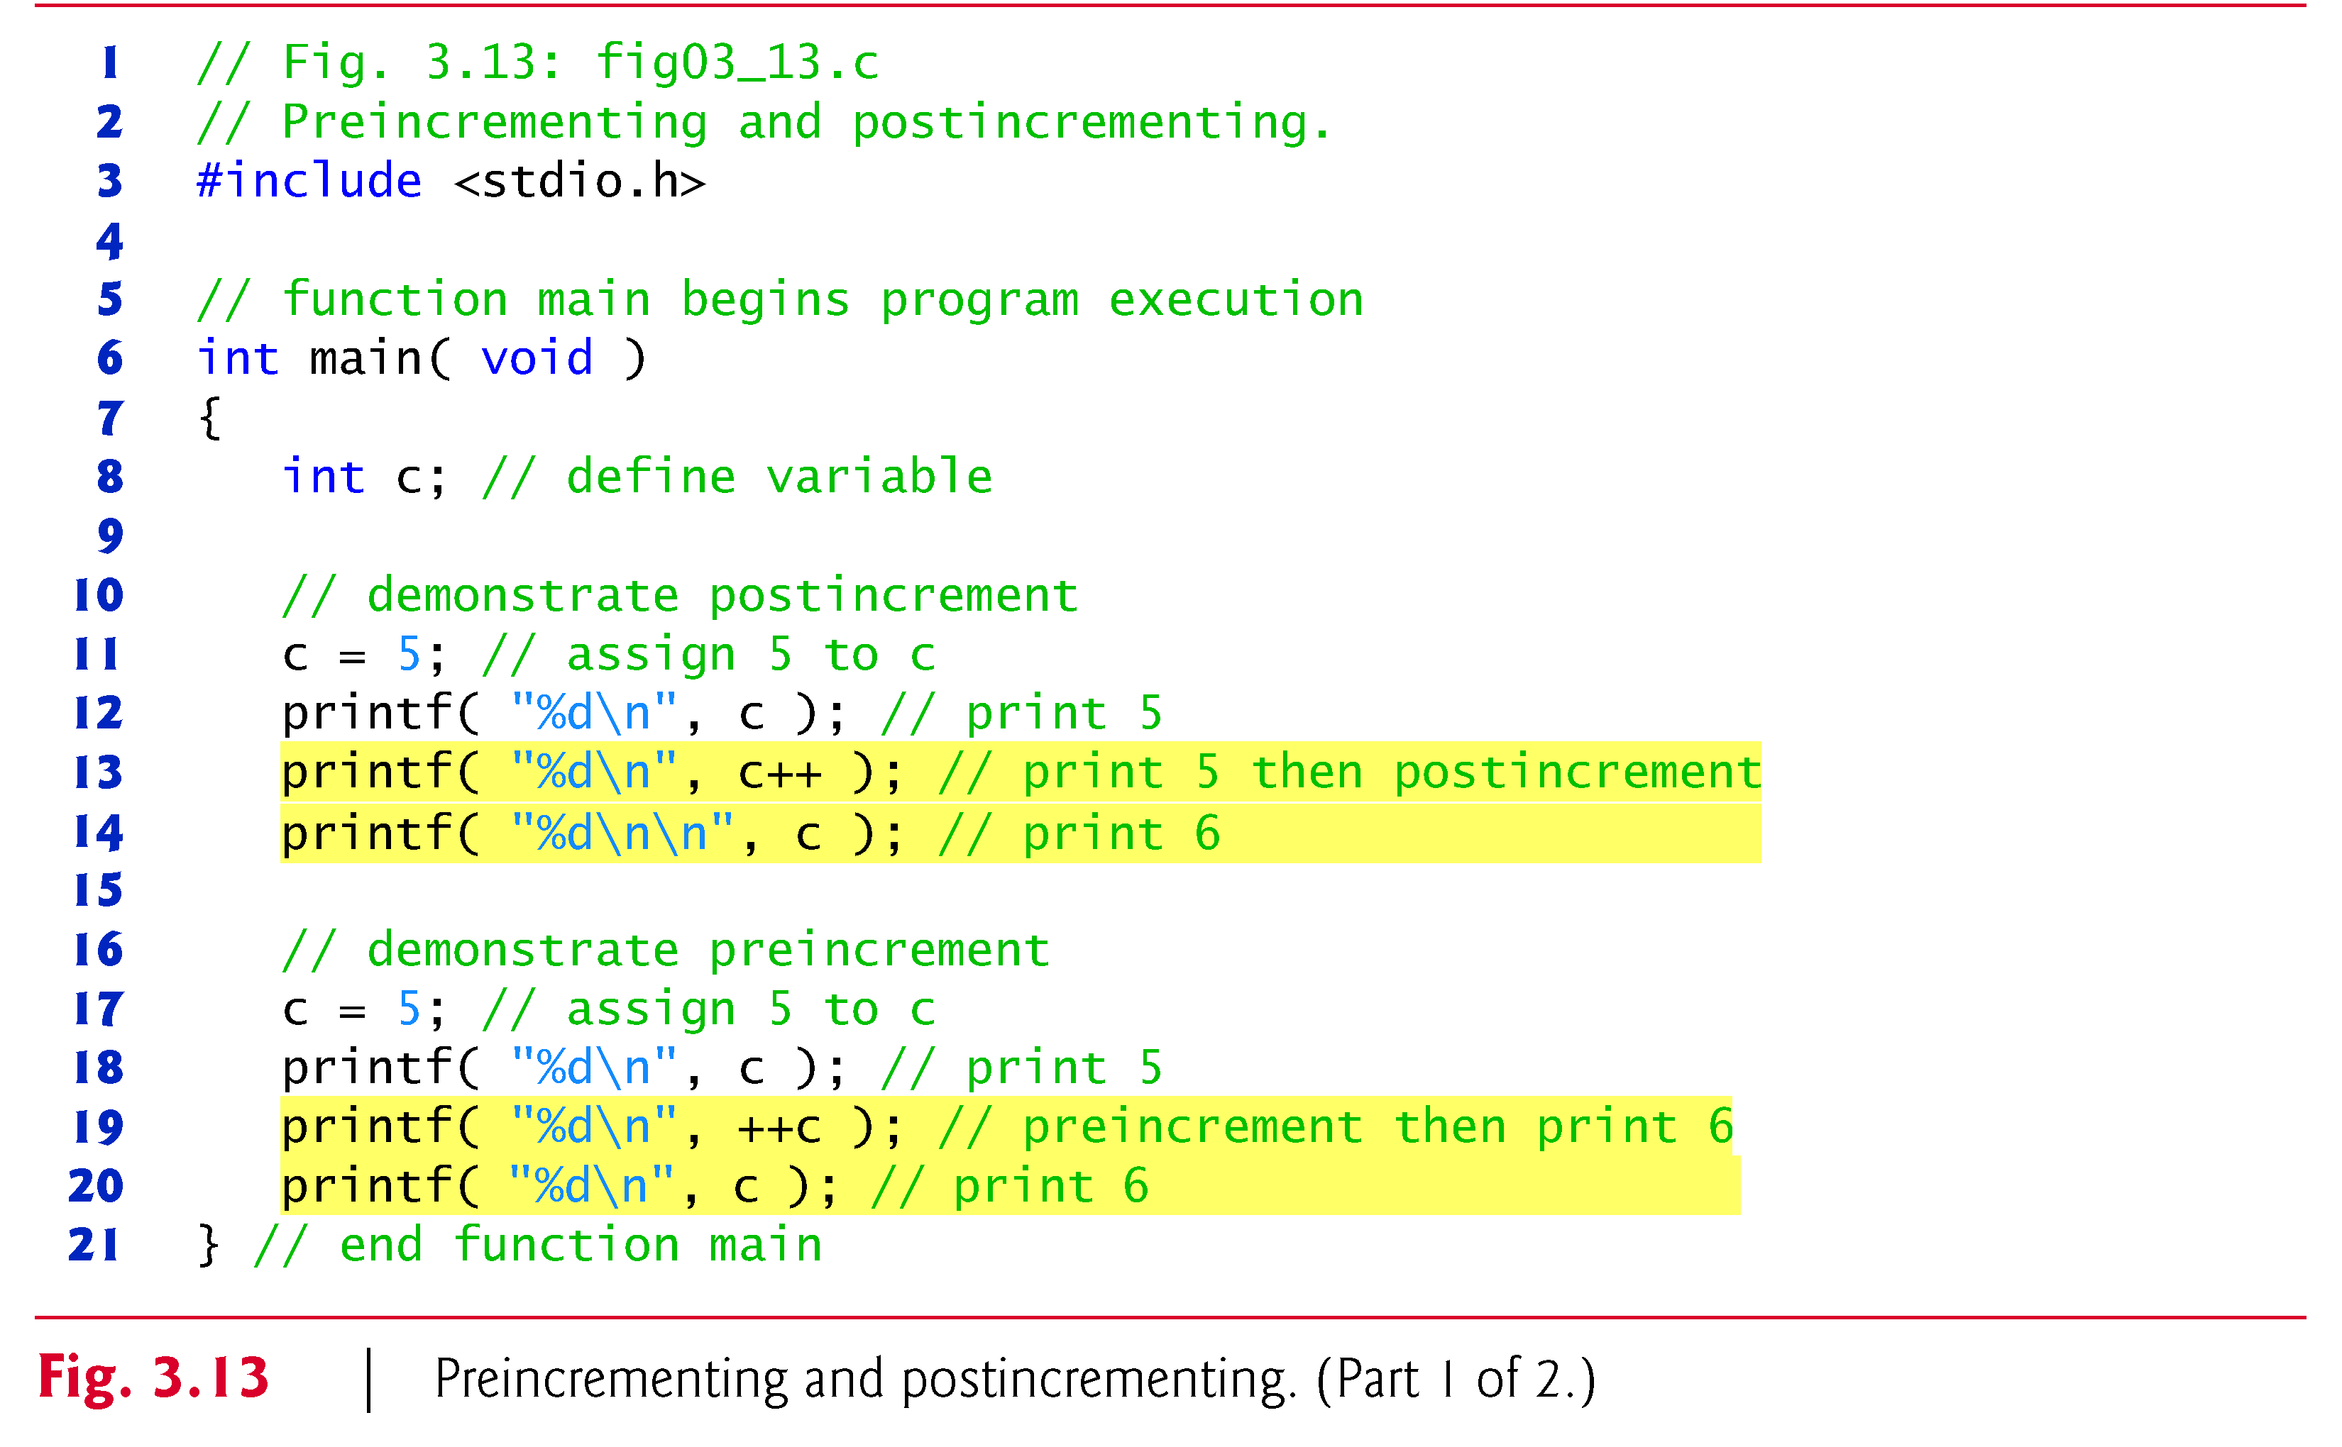
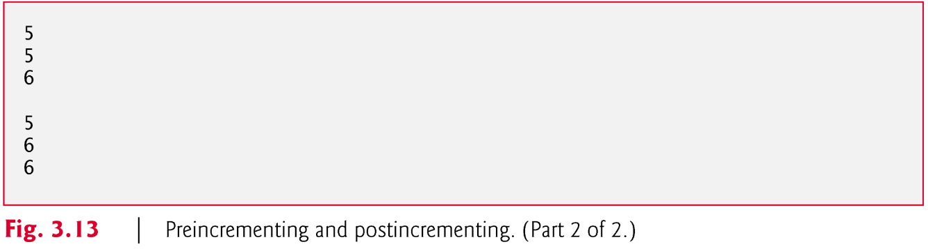

Slide 87
3.12 Increment and Decrement Operators (Cont.)
The three assignment statements in Fig. 3.10
passes = passes + 1; failures = failures + 1; student = student + 1;
can be written more concisely with assignment operators as
passes += 1; failures += 1; student += 1;
with preincrement operators as
++passes; ++failures; ++student;
or with postincrement operators as
passes++; failures++; student++;

Slide 88
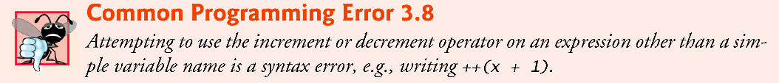
3.12 Increment and Decrement Operators (Cont.)
It’s important to note here that when incrementing or decrementing a variable in a statement by itself, the preincrement and postincrement forms have the same effect.
It’s only when a variable appears in the context of a larger expression that preincrementing and postincrementing have different effects (and similarly for predecrementing and postdecrementing).
Of the expressions we’ve studied thus far, only a simple variable name may be used as the operand of an increment or decrement operator.

Slide 89
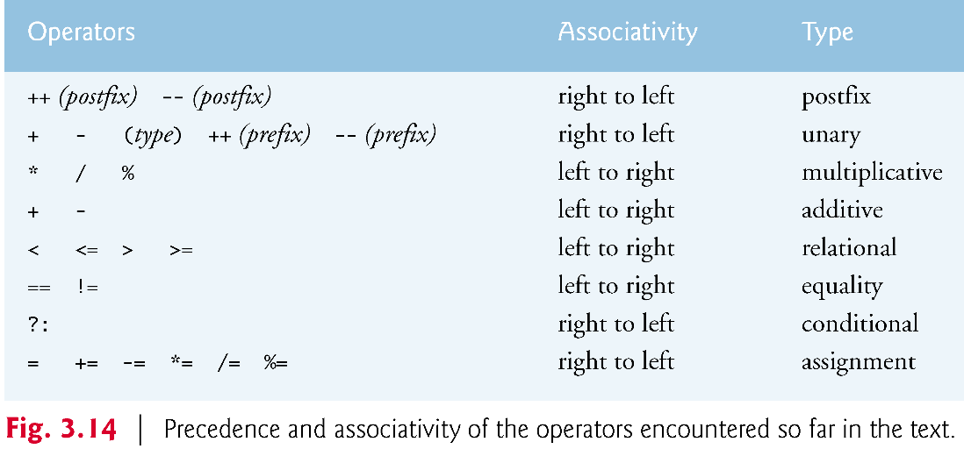
3.12 Increment and Decrement Operators (Cont.)
Figure 3.14 lists the precedence and associativity of the operators introduced to this point.
The operators are shown top to bottom in decreasing order of precedence.
The second column indicates the associativity of the operators at each level of precedence.
Notice that the conditional operator (?:), the unary operators increment (++), decrement (--), plus (+), minus (-) and casts, and the assignment operators =, +=, -=, *=, /= and %= associate from right to left.
The third column names the various groups of operators.
All other operators in Fig. 3.14 associate from left to right.

Slide 90
3.13 Secure C Programming
Arithmetic Overflow
Below is an addition program which calculated the sum of two int values with the statement
sum = integer1 + integer2; // assign total to sum
Even this simple statement has a potential problem—adding the integers could result in a value that’s too large to store in an int variable.
This is known as arithmetic overflow and can cause undefined behavior, possibly leaving a system open to attack.

Slide 91
3.13 Secure C Programming (Cont.)
The maximum and minimum values that can be stored in an int variable are represented by the constants INT_MAX and INT_MIN, respectively, which are defined in the header <limits.h>.
You can see your platform’s values for these constants by opening the header <limits.h> in a text editor.
It’s considered a good practice to ensure that before you perform arithmetic calculations, they will not overflow.
The code for doing this is shown on the CERT website www.securecoding.cert.org—just search for guideline “INT32-C.”
The code uses the && (logical AND) and || (logical OR) operators, which are introduced in the Chapter 4.

Slide 92
3.13 Secure C Programming (Cont.)
Unsigned Integers
In general, counters that should store only non-negative values should be declared with unsigned before the integer type.
Variables of unsigned types can represent values from 0 to approximately twice the positive range of the corresponding signed integer types.
You can determine your platform’s maximum unsigned int value with the constant UINT_MAX from <limits.h>.

Slide 93
3.13 Secure C Programming (Cont.)
The class-average program in Fig. 3.6 could have declared as unsigned int the variables grade, total and average.
Grades are normally values from 0 to 100, so the total and average should each be greater than or equal to 0.
We declared those variables as ints because we can’t control what the user actually enters—the user could enter negative values.
Worse yet, the user could enter a value that’s not even a number. (We’ll show how to deal with such inputs later in the book.)

Slide 94
3.13 Secure C Programming (Cont.)
Sometimes sentinel-controlled loops use invalid values to terminate a loop.
For example, the class-average program of Fig. 3.8 terminates the loop when the user enters the sentinel -1 (an invalid grade), so it would be improper to declare variable grade as an unsigned int.
As you’ll see, the end-of-file (EOF) indicator—which is introduced in the next chapter and is often used to terminate sentinel-controlled loops—is also a negative number.

